Slide 1

Florida Medicare Claims Data Analysis
Class: Cardiovascular Diseases

Slide 2
Mythology for Analysis
Understanding Data
What is the data telling us?
How can we use it for decision making?
Step 1
Data Retrieval
Correct Formatting
Step 2
Data Profiling
Documentation
Step 3
Data Cleaning
Filtering
Step 4
Analysis
Meaningful Conclusions

Slide 3
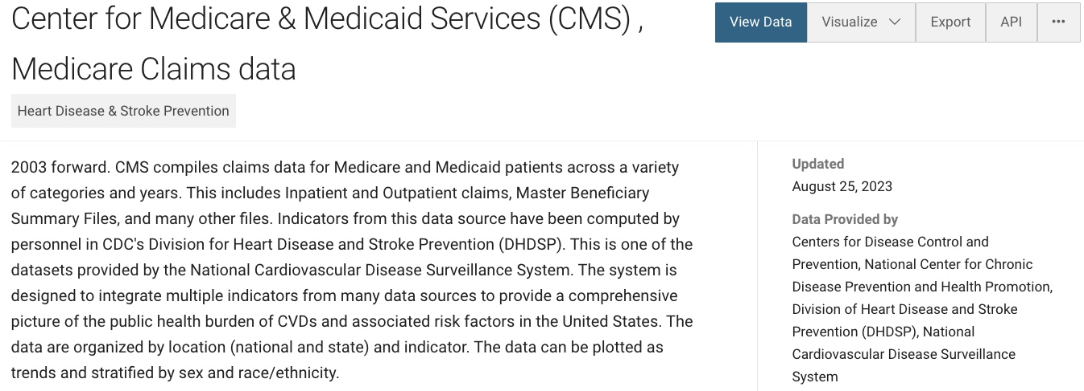
Data Documentation

Slide 4
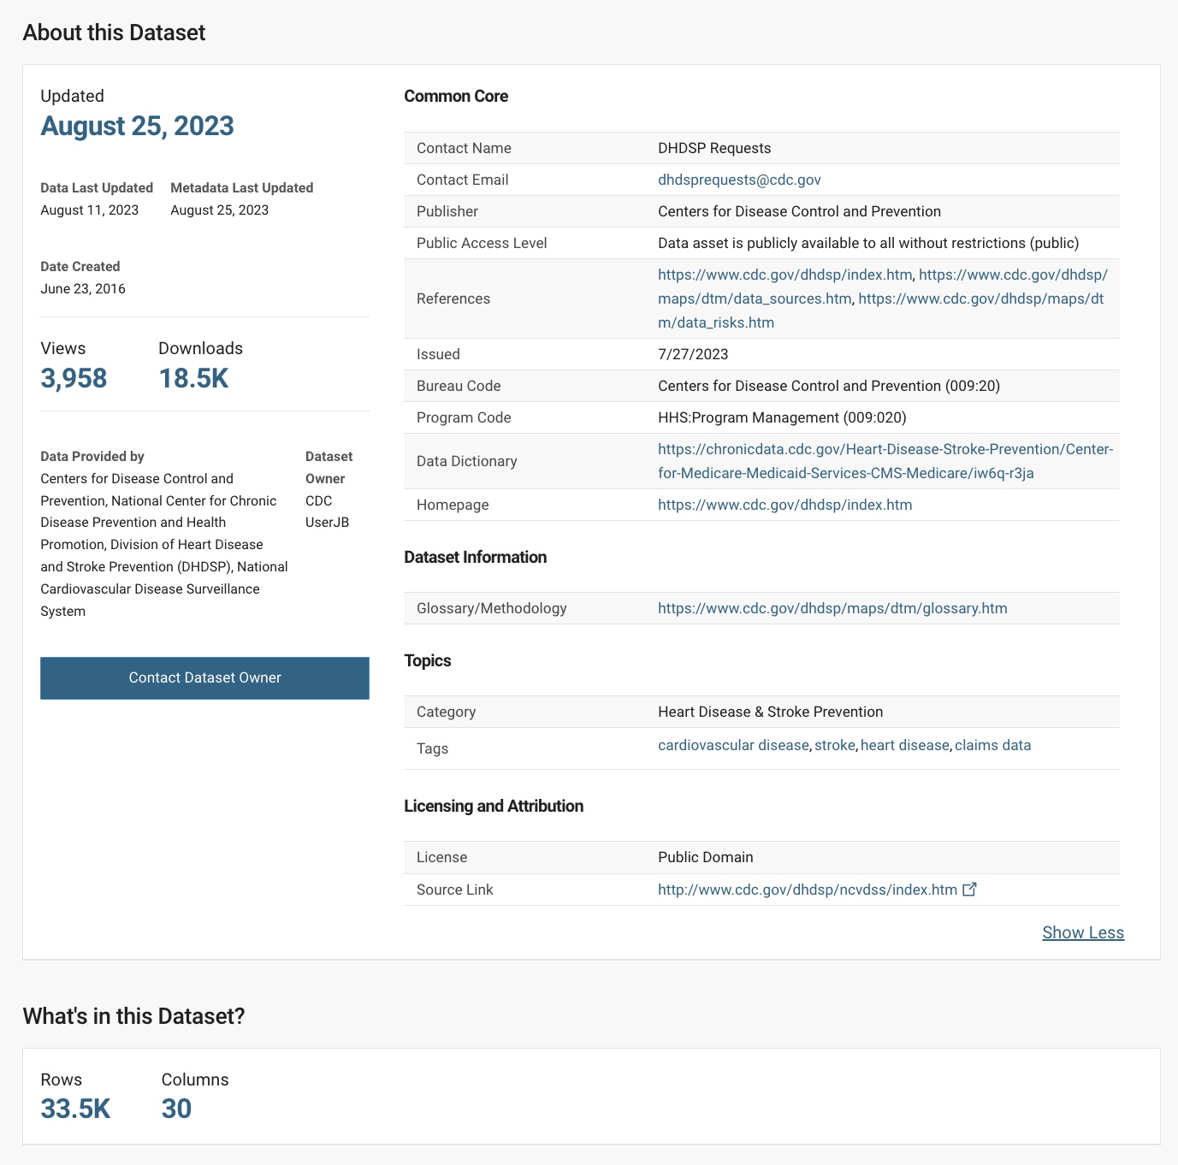
Data Source
Heart Disease & Stroke Prevention
https://data.cdc.gov/Heart-Disease-Stroke-Prevention/Center-for-Medicare-Medicaid-Services-CMS-Medicare/iw6q-r3ja

Slide 5
Medicare Fee-For-Service
ANNUAL data are FINALIZED claims files
Provider-submitted Claims for Payment
Medicare is the primary health insurance program for individuals
*65 or older
*Under age 65 with certain disabilities
*Of all ages with End-Stage Renal Disease (ESRD)
https://www.cdc.gov/nchs/tutorials/nhanes-cms/orientation/overview.htm

Slide 6
Drill Down Sample

Slide 7
Annual Comparison
Data_Value_Unit | Rate per 100,000
Sum of Data_Value | Column Labels
Row Labels | FL | US | Grand Total
2016 | 115187.7 | 117880.2 | 233067.9
2017 | 107840 | 110596.5 | 218436.5
2018 | 104796.6 | 107611.5 | 212408.1
2019 | 105611.1 | 107404 | 213015.1
2020 | 88190.3 | 87926.3 | 176116.6
2021 | 91708.7 | 91641.1 | 183349.8
Grand Total | 613334.4 | 623059.6 | 1236394

Slide 8
Racial Demographics

Slide 10

Conclusion

